Slide 1
Bell Ringer
Why is each of these physical features important to Georgia?
Okefenokee Swamp
Savannah River
Chattahoochee River
Barrier Islands

Slide 2
Georgia’s Transportation Systems

Slide 3
Standard
SS8G2 The student will explain how the
Interstate Highway System, Hartsfield
Jackson International Airport, Georgia’s
deepwater ports, and the railroads help
drive the state’s economy.
a. Explain how the four transportation systems interact to provide domestic and international goods to the people of Georgia.

Slide 4
b. Explain how the four transportation systems interact to provide producers and service providers in Georgia with national and international markets.
c. Explain how the four transportation systems provide jobs for Georgians.
Essential Question
How do Georgia’s transportation systems provide jobs for Georgians?

Slide 5
Today’s Agenda
Opening: Okefenokee Swamp Video
Work Session: ~ PowerPoint Notes
~ Video Log
Closing: Class DoJo Extra Credit

Slide 6
Okefenokee Swamp
http://www.gpb.org/georgiastories/story/okefenokee_swamp
Record at least 2 facts on your video log

Slide 7
Interstate Highway System
~ After WWII President Eisenhower wanted to connect major cities for national defense and to improve the economy
~ Many interstates run through Atlanta making it a huge highway transportation hub
~ I-95 and I-75 connects Georgia to numerous states
~ Tractor Trailers transport goods on interstates from factories to other states and to sea ports for shipping overseas

Slide 8
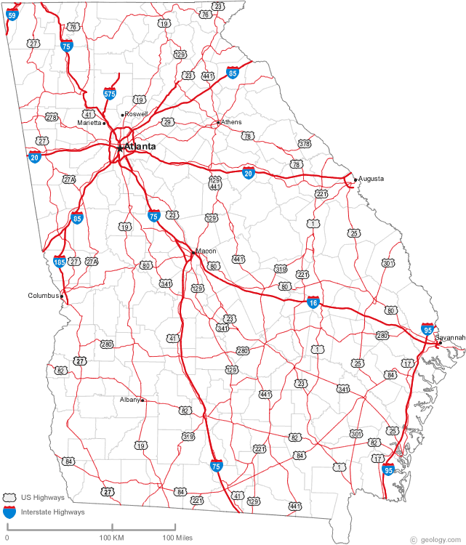

Slide 9
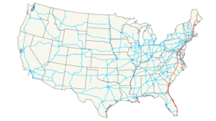
I-95

Slide 10
Hartsfield-Jackson International Airport
~ located in Atlanta
~ one of the busiest airports in the world
~ processes more than 1,000 planes daily that carry people and cargo
~ flights from Atlanta go to 5 continents
~ houses 32 airlines and 200 concessions making it one of the largest employers in the state

Slide 11
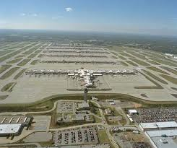

Slide 12
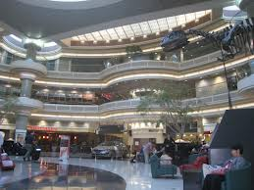

Slide 13
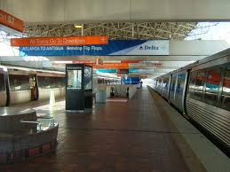

Slide 14
Deepwater Ports (Shipping)
~ the majority of products imported and exported travel on large container ships
~ products from all over world enter our country through Georgia’s shipping ports
~ automobiles & bulk goods come through Brunswick port
~ container cargo come through Savannah port (4th busiest port in the U.S.)

Slide 15
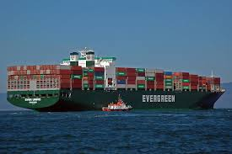

Slide 16
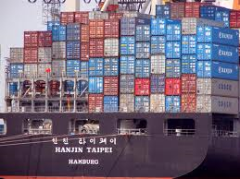

Slide 17
Railroads
~ created in Georgia during the mid 1800’s to link major cities in the state together (Athens, Augusta, & Savannah)
~ many new cities sprung up around rail lines (including Atlanta)
~ travel by rail dominated for 130 years but decreased as interstate highways increased
~ today trains carry cargo in and out of our state as well as people
~ CSX & Norfolk Southern (cargo) and Amtrak (people)

Slide 18
Interstates
http://www.gpb.org/georgiastories/stories/interstate_highway_system
Record at least 2 facts that will be shared.

Slide 19
Hartsfield-Jackson International Airport
http://www.gpb.org/georgiastories/stories/second_busiest_airport_in_the_world
Record at least 2 facts that will be shared.

Slide 20
Railroads
http://www.gpb.org/georgiastories/stories/railroads_economic_boom
Record at least 2 facts that will be shared.

Slide 21
Closing
How do Georgia’s transportation systems provide jobs for Georgians?
Answer in at least 3 sentences.

