Slide 1
Life in the New Georgia Colony
GPS: SS8H2b

Slide 2
Set-Up Your Page & Get Ready to Take Notes
Name: ______________
Date:_______________
Period: _____________
Class: Social Studies
Topic: Life in the New Georgia colony
E.Q.
Why were people relocating to the Georgia colony?
What role did the Malcontents, Highland Scots, Salzburgers, and Spanish in Florida play in the growth and development of the Georgia colony?

Slide 3
Enduring Understanding & GPS
Enduring Understanding: Movement & Migration, Distribution of Power
GPS:
SS8H2:The student will analyze the colonial period of Georgia's history. b) Evaluate the Trustee Period of Georgia's colonial history, emphasizing the role of the Salzburgers, Highland Scots, malcontents and the Spanish threat from Florida.

Slide 4
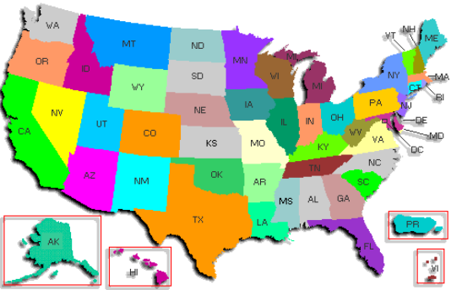
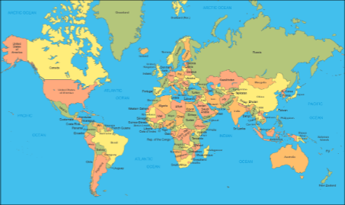
Where are you from?

Slide 5
Why did your family decide to move to Georgia?
Job Opportunity?
To be close to family?
New Start?
Weather?
Military Relocation?
Other?

Slide 6
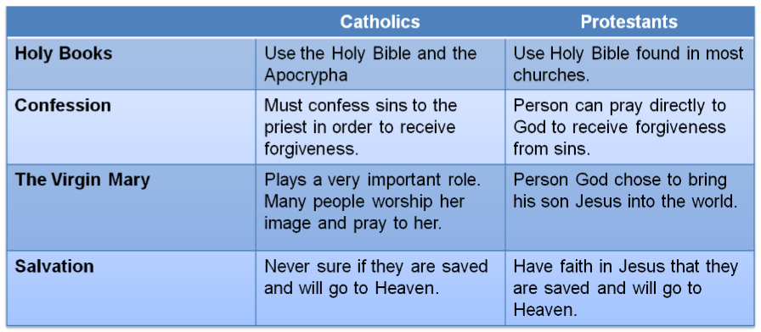
Protestants versus Catholics
What is the difference between the Catholic and Protestant faiths?
Catholics and Protestants (Baptist, Pentecostal, Lutheran, Methodist, Episcopal, Apostolic, etc.) believe some of the same things, but also some different things.

Slide 7
Protestants versus Catholics
Why was there conflict between Protestants and Catholics in Europe?
Why did Protestant flee to the Georgia colony and the other 12 colonies?
Protestant Reformation (1500s): Leaders, such as Martin Luther and John Calvin, began to speak out against the Catholic church saying their beliefs were wrong.
Many European countries, such as France and England, decided which religion would be the dominant religion and would help govern the country.
The religion with the most political influence would persecute (drive-out, kill) people from the opposing religion.
Protestants came to the Georgia colony and other 12 colonies because they were not allowed and they could practice their religion freely.

Slide 8
Quick Review Question 1
Which statement best describes why people from Europe were relocating to the Georgia colony and other 12 colonies?
The black plague was killing thousands of Europeans as it spread from country to country.
The gold rush in southern California.
To escape religious persecution and have the opportunity to practice their religion freely.
To serve as indentured servants in exchange for a paid trip over to America.

Slide 9
Quick Review Question 2
What role did religion play in government in Europe during colonial times?
Religion was a way for people to spend their free time.
Religious leaders served as monarchs and ruled over many European countries.
Religion did not play a role in government due to separation of church and state.
Monarchs would decide the religion of the country for the people to follow. Religious leaders would advise the monarch on important decisions.

Slide 10
Quick Review Question 3
Which statement BEST describes the differences between the Catholic and Protestant faiths?
Catholics believe in performing animal sacrifices to seek forgiveness of their sins and Protestants believe in walking on hot coals as a way to seek forgiveness.
Protestants pray to Mary as a way to communicate with God and ask for forgiveness of sins and Catholics pray to Apocrypha to seek guidance.
Mary plays a significant role in the Catholic faith and does not in the Protestant faith.
There is no difference between the Catholic and Protestant faiths.

Slide 11
New Colonists Arrive in Georgia
Forty original settlers died in the first year.
In 1733, 42 Jews were allowed to settle in Georgia, including a much-needed doctor, Dr. Samuel Nunis.

Slide 12
Salzburgers in Georgia
Where were they from?
The Salzburgers were from Salzburg, Germany. They first arrived in Georgia in 1733.
Why did they come to Georgia?
The Salzburgers were Protestants, but Germany was controlled and governed by Catholics. Protestants and Catholics are considered Christians.
They moved to Georgia to escape religious persecution; there were differences in religious beliefs between the Protestants and Catholics.
They were free to practice their religion in Georgia.
The Salzburgers were led by John Martin Bolzius.

Slide 13
Salzburgers in Georgia
What was their impact on Georgia?
The Salzburgers arrived, and settled a town called Ebenezer, about 25 miles from Savannah.
Ebenezer means “Rock of Help.”
Three years later they moved to Red Bluff and settled New Ebenezer because there was little water and the soil quality was poor (could not grow crops).
They planted mulberry trees from growth of silkworms and to make silk.

Slide 14
Salzburgers in Georgia
Oglethorpe and Chief Tomochichi returned from a trip to England in 1736 with 300 more settlers, including German Morivans from Salzburg and Saxony. Religious leaders John and Charles Wesley also arrived in Georgia.
John Wesley was the founder of the Methodist church.

Slide 15
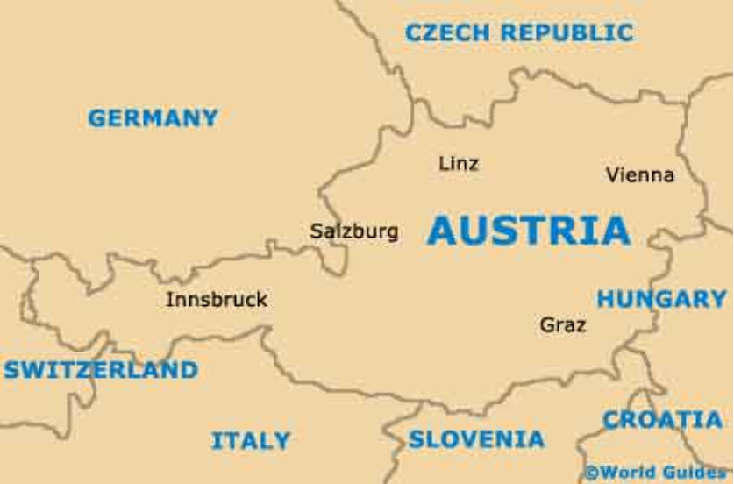

Slide 16
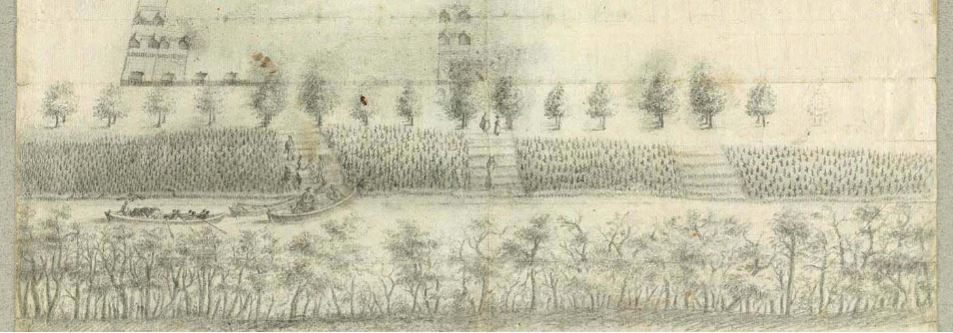
Ebenezer, Georgia, under construction by the Salzburgers, February/March 1734
Notes:
http://nationalhumanitiescenter.org/pds/becomingamer/growth/text4/germansgeorgia.pdf

Slide 17
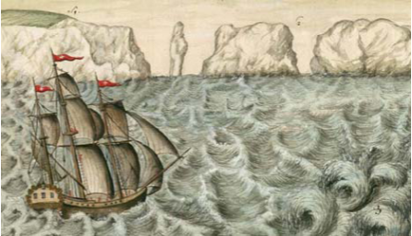
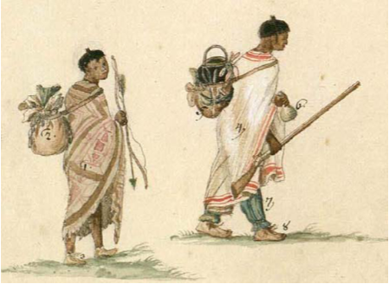
E B E N E Z E R
(“Rock of Help”)
A Refuge for German Protestants in Georgia, founded 1734
as described in the journals of leaders Rev. Johann Martin Bolzius and Philip Georg Friedrich von Reck
In 1734, just a year after Georgia had been founded by James Oglethorpe, a group of German Protestants arrived to create a new town, Ebenezer, as a refuge for Lutherans expelled from Catholic-controlled Salzburg (in the Alps Mountains in present-day Austria). Its leaders included Rev. Johann Martin Bolzius and Philip Georg Friedrich von Reck, whose journals are excerpted here, along with several of von Reck’s drawings. Because the first town was poorly sited⎯too far from the coast and river trans-portation⎯a second town, New Ebenezer, was built two years later on the Savannah River. The town flourished until it was destroyed by the British during the Revolutionary War.

Slide 18
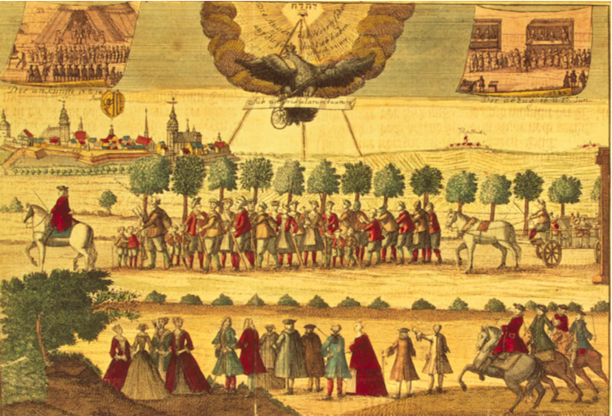
The Expulsion of the Salzburgers On October 31, 1731, the Catholic ruler of Salzburg, Austria, Archbishop Leopold von Firmian, issued an edict expelling as many as 20,000 Lutherans from his principality. Many property less Lutherans, given only eight days to leave their homes, froze to death as they drifted through the winter seeking sanctuary. The wealthier ones who were allowed three months to dispose of their property fared better. Some of these Salzburgers reached London, from whence they sailed to Georgia. Others found new homes in the Netherlands and East Prussia.
Notes:
http://www.loc.gov/exhibits/religion/rel01.html

Slide 19
Highland Scots Come to Georgia
Where were they from?
The Highland Scots emigrated from Scotland to the Georgia colony.
Why did they come to Georgia?
They came because James Oglethorpe promised them land.
They also came to escape persecution and for a better life.
The Highland Scots were known to be some of the best soldiers in the world. They were also hard workers.
Settled in Darien, GA along the Altahama River.

Slide 20
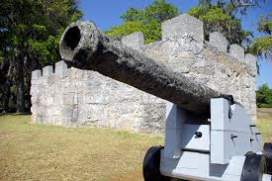
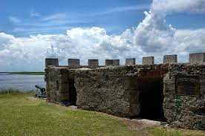
Highland Scots come to Georgia
Why did they come to Georgia?
Were recruited by James Oglethorpe to man Fort Frederica and protect Georgia from the Spanish that were invading the colony from Florida in the south and French from the west.

Slide 21
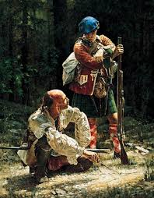
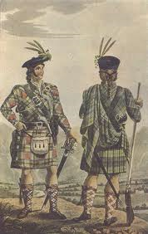

Slide 22
Highland Scots come to Georgia
The Highland Scots kept many of their traditions:
- Spoke Gaelic
- Close family clans
- Wore kilts instead of pants
- Traditions are still celebrated today with festivals including the Highland Scots festival at Stone Mountain park.
They cattle and harvested timber due to poor soil conditions in the area.
The Highland Scots were against slavery.

Slide 23
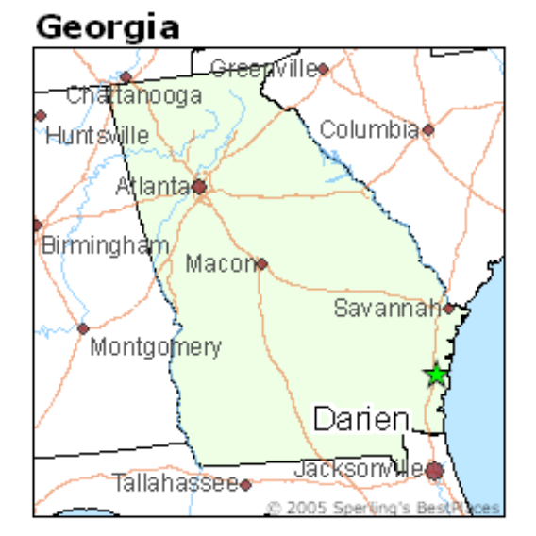

Slide 24
Quick Review Question 4
The Salzburgers came to Georgia in search of
a new home to practice their religion because they have been ousted from their home in Salzburg, Germany.
gold and riches.
a milder climate because many Salzburgers were dying due to the cold climate in Germany.
the Spanish Missions built on the Barrier Islands.

Slide 25
Quick Review Question 5
How did the efforts by the Highland Scots encourage the growth and development of the Georgia colony?
The agricultural products they produced were used to trade with the Native Americans to keep peace.
They built homes along the Savannah River for new settlers to live in as they arrived in Georgia.
They taught the Native Americans English and European customs.
The Highland Scots manned Fort Frederica and fought Spanish advances into colony from Florida.

Slide 26
The Malcontents: Georgia’s Colonists are Unhappy
Where were they from?
Colonists that were discontent (upset) were called malcontents.
The malcontents were unhappy and complained about the regulations that governed the colony.
Why were they unhappy?
When James Oglethorpe returned to the colony after a trip to Great Britain he introduced several “new” regulations that were approved by the trustees.
The regulations were:
- Colonist were not allowed rum trade with Native Americans
- Slavery because Oglethorpe thought that the colonists
should work and not be lazy or greedy for more land.
Land ownership was also a problem – only males could inherit land.

Slide 27
The Malcontents: Georgia’s Colonists are Unhappy
South Carolina used slave labor to successfully grow rice, tobacco, and cotton on large plantations. Farmers in Georgia wanted the same “success” that South Carolina farmers had.
Many Georgians moved to places in the colony where they basically could live as they wished.
What was their impact on Georgia?
Their voices were heard – eventually leading to changes in regulations in the colony.
By 1742, Georgians were allowed to buy and sell rum. Slavery was introduced in 1750. The colony named for King George II was changing.

Slide 28
The Spanish Threat from Florida
The War of Jenkin’s Ear broke out between Great Britain and Spain in 1739.
Oglethorpe organized an army of about 2,000 men with plans to capture Spanish forts in Florida.
Spain responded and forced the Georgians, South Carolinians, and their Indian allies to retreat to St. Simon’s Island.
The Battle of Bloody Marsh in 1742 caused the Spanish to flee Georgia, marking the end to Spanish threats. Georgia’s southern border was protected.
Oglethorpe left the Georgia colony for England in 1743 and never returned.

Slide 29
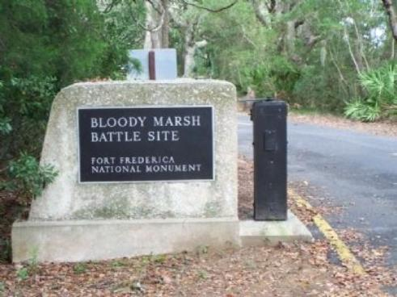
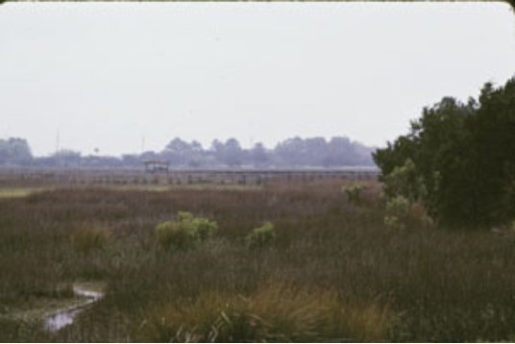

Slide 30
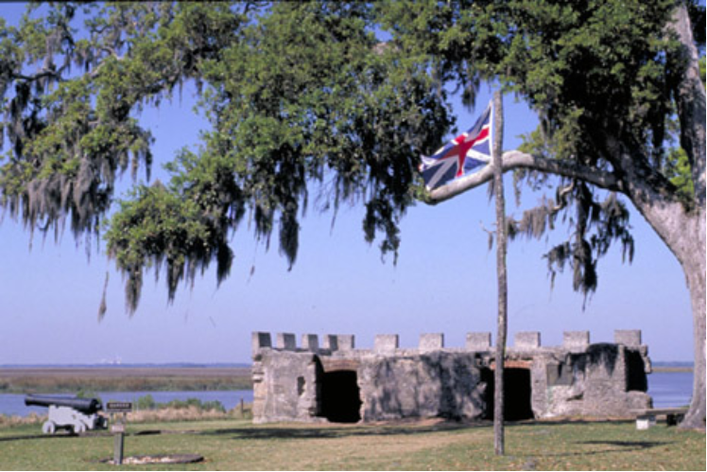

Slide 31
Quick Review Question 6
James Oglethorpe’s rules and regulations upset many of the colonists causing them to become discontent. Why were they discontent?
The colonists were upset that James Oglethorpe increased taxes and limited the number of immigrants into the colony.
The colonists were upset that their neighbors in South Carolina were more prosperous because they could drink alcohol and own slaves.
Catholics were now allowed to join the colony.
King George II demanded that all colonists pay a loyalty tax.

Slide 32
Quick Review Question 7
What was the outcome of the Battle of Bloody Marsh?
James Oglethorpe was killed and his body was later returned to England to be buried.
The Spanish defeated the colonists and took control of Georgia’s southern border.
Tomochichi and John Musgrove surrendered Yamacraw Bluff to the Spanish soldiers in exchange for their freedom.
The colonists and James Oglethorpe successfully defended the Georgia colony, protecting the southern border.

Slide 33
The Georgia Colony After James Oglethorpe Leaves
Three different men served as president of the Georgia colony from the time Oglethorpe left the colony until 1754: William Stephens, Henry Parker, and Patrick Graham.
In 1752, one year before the initial 21-year charter was to expire, the trustees returned Georgia to the authority of King Georgia II. It becomes a royal colony.
In its first 20 years as a colony, Georgia’s population grew to 5,500 people, of which one-third were slaves. Protestants from Europe found safe haven in Georgia.
Treaties with Native Americans and victory over the Spanish settlers in Florida provided security to the Georgia colonists.

Slide 34
Early Georgia Colony Accomplishments
The Bethesda Orphans Home was established in Ebenezer.
The orphanage later became Bethesda House School, where many of Georgia’s early leaders were educated.
The Methodist Church was founded by John and Charles Wesley.
The first Sunday School in America is established by the Wesley brothers.
A successful court system was established and maintained.
Women were able to inherit property.

