Slide 1
Georgia’s
5 Geographic
Regions
Mrs. West – CMS
SS8G1b

Slide 2
Enduring Understanding
Location: The student will understand that location
affects a society’s economy,
culture, and development.

Slide 3
Georgia Performance Standard
SS8G1b - Describe the five geographic regions of Georgia; include the Blue Ridge Mountains, Valley and Ridge, Appalachian Plateau, Piedmont, and Coastal Plain.

Slide 4
Essential Questions
Which North American geographic regions are found in Georgia and what are some distinguishing characteristics of each?
What is the relative location of these physiographic regions within the boundaries of the State?

Slide 5
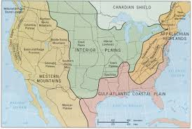
Georgia’s 5 geographic regions are a part of the geographic regions that run through the country.

Slide 6
What are the 5 geographic regions found in Georgia?
Appalachian Plateau
Ridge & Valley
Blue Ridge
Piedmont
Coastal Plain

Slide 7
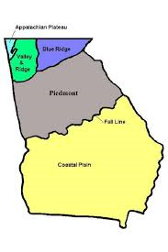

Slide 8
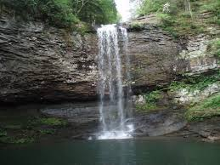
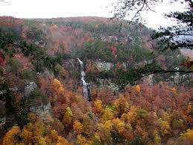
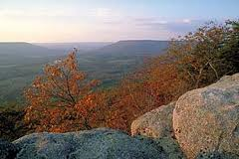
Appalachian Plateau

Slide 9
Appalachian Plateau
Located in the northwest corner of the state, it includes Dade county and part of Walker county.
It is the smallest region in Georgia.
Referred to as the TAG Corner because it is where Tennessee, Alabama, and Georgia meet.
There are many limestone caves, deep canyons, and interesting rock formations.
The soil is a mixture of limestone, shale, and sandstone, making it to poor to grow agricultural crops.
Coal can be found in the region, but there is no active mining.

Slide 10
Appalachian Plateau
The region has hardwood forests and pastures.
Historic Civil War battles occurred in the region.
Cloudland Canyon is located here.
The start of the Appalachian Trail is located between the Appalachian Plateau and Ridge and Valley Regions at Springer Mountain. The 2,144 mile hike will take you to the state of Maine.

Slide 11



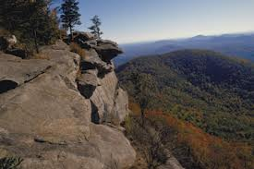
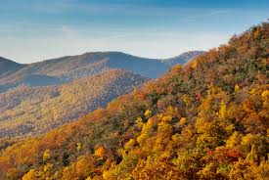
Ridge & Valley

Slide 12
Ridge & Valley
Located between the Blue Ridge and Appalachian Mountains.
The region has low open valley and narrow mountainous ridges.
The soil is very fertile; a mixture of shale and sandstone in the ridges, and limestone and clay in the valleys.
The region has forests, pastures, and fertile farmlands.
Major cities in the region include Cartersville, Calhoun, and Dalton.
Dalton is considered the most important city in the region because of the textile (ex. rugs and towels) and carpet industry.
Dalton is considered the “Carpet Capital” of the world.
Historic Civil War battles occurred in the region.

Slide 13

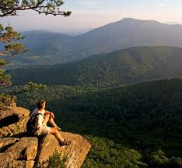
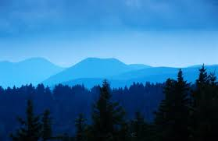
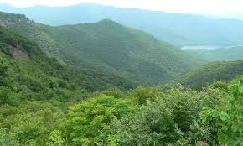
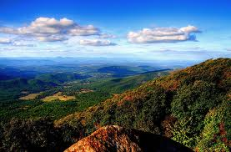
Blue Ridge

Slide 14
Blue Ridge
Located in the northeastern part of the state.
The highest and largest area of mountains in the state is located here.
The mountains in the Blue Ridge region are important because they block warm-moist air coming up from the Gulf of Mexico. When the warm air meets with the cool temperatures of the mountains it cools.
As a result precipitation (rain, hail, snow) forms. The precipitation that falls in the region provides drinking water for the entire state.
Most of the state’s rivers begin in the Blue Ridge region.

Slide 15
Blue Ridge
The soil is a mixture of sandy loam (a blend of clay, sand, and organic matter) and clay. It is very shallow and erosion is a problem
Hardwood forests, vegetables, and apples are grown in the region.
Brasstown Bald, the highest peak in the state, is located here. If you stand on top of it you can see 3 states – SC, NC, and TN.
The region was once known for mining, but tourism is the most popular industry in the region because of the beautiful scenic views and mountains.

Slide 16
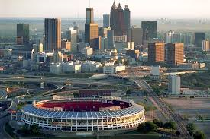

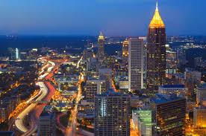
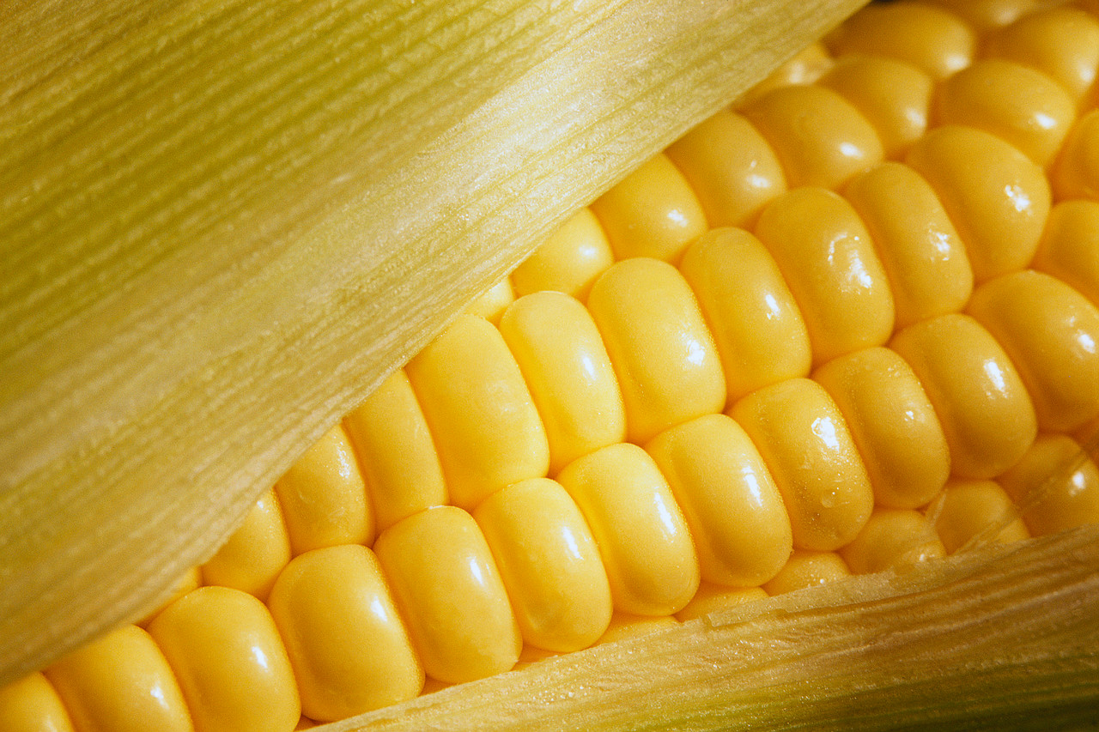
Piedmont

Slide 17
Piedmont
Also known as the Piedmont Plateau.
You live in this region, in fact about ½ of the state’s population lives in this region.
The region begins at the mountain foothills of north Georgia and runs to the center of the state.
It is known as the “Heartland of the State.”
The Piedmont region is home to many large companies such as Delta Airlines, Coca-Cola, Home Depot, Georgia-Pacific, Chick-Fil-A, AT & T, SunTrust Bank, UPS, CNN, Zaxby’s and TBS, TNT, and Cartoon Network.
Major cities located in the region include Atlanta, Athens, Madison, and Milledgeville.

Slide 18
Piedmont
The region has good soil that is good for growing hardwood timber, pine, and agricultural products such as wheat, soybeans, corn, poultry (chicken), and cattle.
Atlanta is also known as the “Hollywood” of the south because of the many movie and television productions taking place here.
There are lots of granite in the region, for example Stone Mountain and Panola Mountain. FYI, they are not really mountains, just huge chunks of rock.

Slide 19
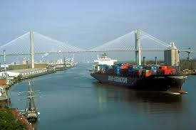
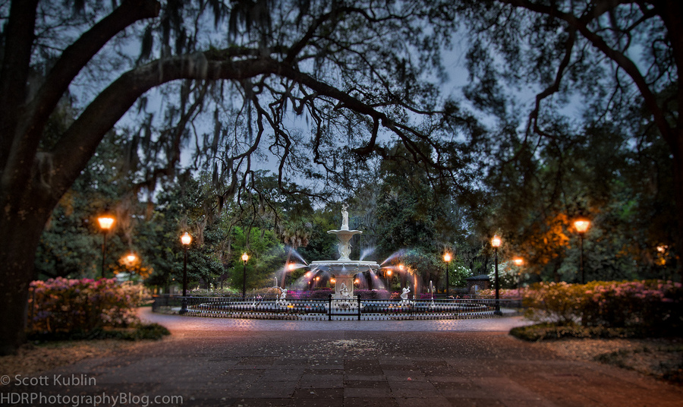
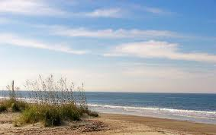
Coastal Plain

Slide 20
Coastal Plain
The coastal plain is the largest region, taking up 3/5 of the state.
It is actually 2 parts, the Inner Coastal Plain and Outer Coastal Plain.
The Inner Coastal Plain:
  Has a mild climate and a good supply of underground water.
  It is the major agricultural center for the state.
  The soil is rich; it varies from limestone to clay.
  Peanuts, peaches, corn, pecan trees, cotton, and Vidalia Onions are grown in the region.

Slide 21
Coastal Plain
The Outer Coastal Plain:
  The soil is not very fertile for farming.
  It is the center of naval stores (military) and pulp (paper) production for the state.
  The region has flat-coastline areas, and freshwater wetlands and swamps.
  The Okefenokee Swamp is located here. It is the largest freshwater swamp in North America.

Slide 22
Coastal Plain
The Barrier Islands are located in this region.
The two main deepwater ports are also located here. At the ports, goods are shipped in and out of the state and country: Savannah and Brunswick
Tourism, shipping, and seafood are also important industries to the region.
Major cities include Savannah, Darien, Brunswick, and Columbus.

Slide 23
Choice Activity
Double bubble blast!
  Using the double bubble graphic organizers, compare and contrast the similarities and differences of the unique characteristics of the 2 regions.

