Slide 1
A New Government for a New Country
Fall 2014-15
GPS: SS8H4a & b
Mrs. Kim West

Slide 2
Let’s Get Started
Set-up your paper for Cornell Notes.
Write down the following on your paper.
Name
Social Studies
Period 3, 4, 5 or 6
Today’s Date: November 11, 2014

Slide 3
Topic
Statehood
How our country became known as the United States of America and the first states joined the Union.

Slide 4
Enduring Understanding
Governance
The student will understand that as a society increases in complexity and interacts with other societies, the complexity of the government also increases.

Slide 5
Georgia Performance Standards
SS8H4 The student will describe the impact of events that led to the ratification of the United States Constitution and the Bill of Rights.
a. Analyze the strengths and weaknesses of both the Georgia Constitution of 1777 and the Articles of Confederation and explain how weaknesses in the Articles of Confederation led to a need to revise the Articles.

Slide 6
Essential Question
What were the strengths and weaknesses of the Articles of Confederation and Georgia Constitution of 1777 and how were these weaknesses addressed?
How did past experience of the patriots with England’s monarchy influence their decisions regarding a new form of government?

Slide 7
Review
After the Revolutionary War, the American colonists were free from British rule for good.
The 13 colonies had to come together to create a government to govern the entire country and the individual colonies, which were now states.

Slide 8
Review
The colonists did not want a government like the British government. That meant that they did not want the country’s government to be all powerful.
The national government had power, but the states’ also had power to govern themselves.
The people should also be involved in the government.

Slide 9
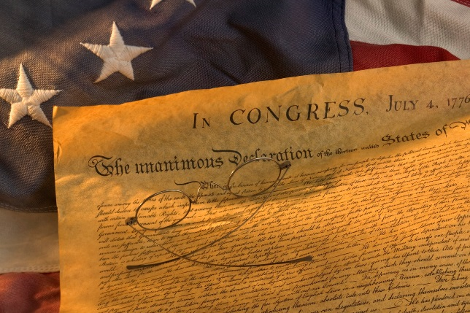
Review: Declaration of Independence
Declaration of Independence
  July 4, 1776
  Signed by Georgians Button Gwinnett, Lyman Hall, and George Walton.
  Listed the colonists grievances against the king.
    Taxes and not representation in the British Parliament.
    King was out of touch with the needs of the colonists.

Slide 10
Slide #1
You will review this section of the notes to create your own level 2 or 3 question or topic.
Three written documents laid the foundation for our country’s government.
  Declaration of Independence
  Articles of Confederation
  U.S. Constitution

Slide 11
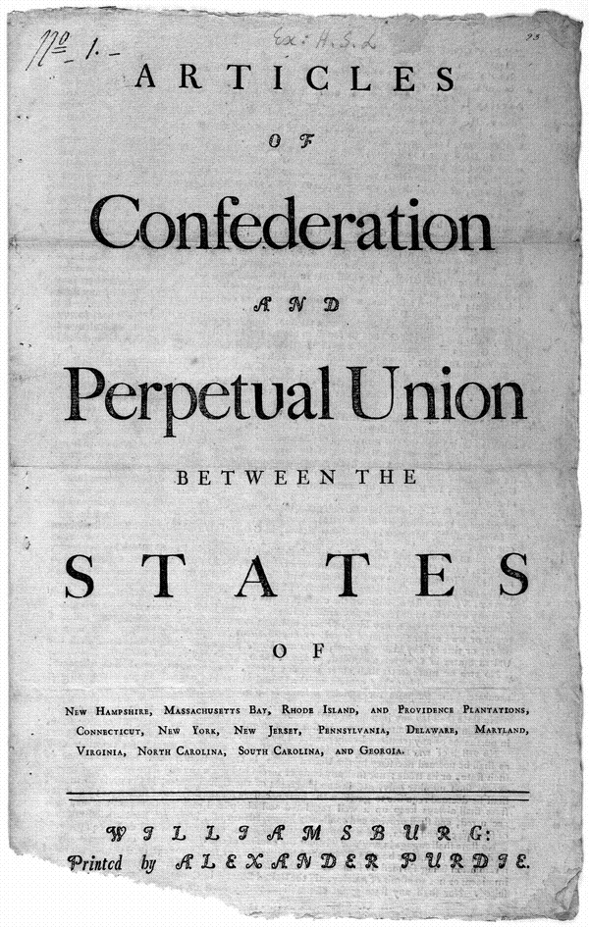
Articles of Confederation: The United States’ First National Government

Slide 12
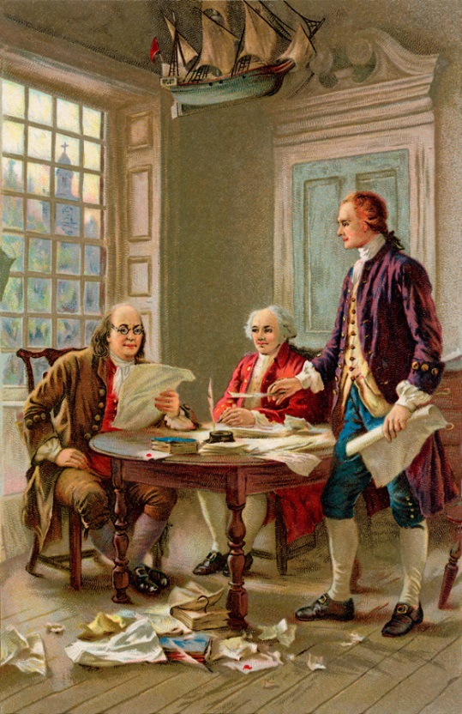
Slide #2
You will review this section of the notes to create your own level 2 or 3 question or topic.
After the Declaration of Independence was written, the Continental Congress (delegates from the 13 colonies) appointed a committee to create a plan for a central government.
The delegates did not want to create a central government that was too powerful considering how badly the British king treated the colonies – ALL POWERFUL MONARCH BE GONE!
The goal was to create a central or national government that was strong enough to make decisions for the entire country, while still ensuring that the states had the power to make their own decisions.

Slide 13
Slide #2 continued
You will review this section of the notes to create your own level 2 or 3 question or topic.
A central government was important to unifying the colonies, now called states.
The unification of the states was important to working together to fight against the British.
The committee quickly wrote the Articles of Confederation, which created a loose alliance of sovereign (independent) states.
The Articles were drafted quickly in November 1777, but ratification (approval) of them was delayed until 1781.

Slide 14

Slide #2 continued
Under the Articles of Confederation (AOC) a national Congress was created.
Delegates from the states represented the interests of the states.
There was only a legislative (law making) branch of government, no executive or judicial branches.
But wait, there were problems with our first national government!!!!
You will review this section of the notes to create your own level 2 or 3 question or topic.

Slide 15
Slide #2 continued
Strengths of the
Articles of Confederation
Weaknesses of the
Articles of Confederation
Congress, the country’s legislative branch of government, was created.
Congress had the sole power to declare war, assign treaties, entertain foreign relations, and operate post offices.
National government could coin money.
Disputes between states and territorial issues were to be brought to Congress.
Little power given to the Congress:
  The Articles gave Congress the power to pass laws but no power to enforce those laws.
  If a state did not support a federal law, that state could simply ignore it.
  No power to levy taxes No way to raise money for the country.
  No way to regulate trade. Each state had it own money.
  Without a federal court system or executive leader, there would be no way to enforce these laws.
Fun Fact!: Under the Articles of Confederation, Canada was invited to join the United States of America. Canada was mainly occupied by Great Britain.

Slide 16
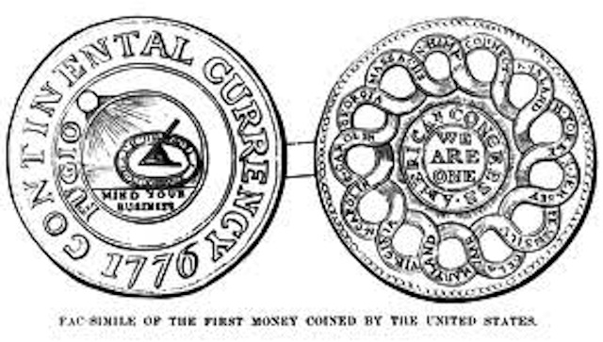

Slide 17
Slide #2 continued
You will review this section of the notes to create your own level 2 or 3 question or topic.
The weaknesses of the Articles of Confederation (AOC) led to the revision of the Articles.

Slide 18
Graded Ticket-Out-the-Door
Review today’s notes by circling key terms, underlining main ideas, or highlighting key information.
Create your own level 2 or 3 question(s) for today’s notes.
Write a summary of what today’s notes were about. Not what you did in class today.

Slide 19
1787 Constitutional Convention

Slide 20
Georgia Performance Standards
SS8H4 The student will describe the impact of events that led to the ratification of the United States Constitution and the Bill of Rights.
b. Describe the role of Georgia at the Constitutional Convention of 1787; include the role of Abraham Baldwin and William Few, and reasons why Georgia ratified the new constitution.. Analyze the strengths and weaknesses of both the Georgia Constitution of 1777 and the Articles of Confederation and explain how weaknesses in the Articles of Confederation led to a need to revise the Articles.

Slide 21
Essential Question
How did the weaknesses of the Articles of Confederation lead to the creation of the current U.S. Constitution?
In what ways did the delegates compromise to create the U.S. Constitution?
What Georgians participated in the 1787 Constitutional Conventions and what were their contributions?

Slide 22
Define the following terms – p. 174 - 175
          Constitutional Convention
          Abraham Baldwin
          William Few
          U.S. Constitution - glossary
          Bill of Rights
          General Assembly

Slide 23
Slide #3
You will review this section of the notes to create your own level 2 or 3 question or topic.
In 1787, the founders realized that the Articles of Confederation were far too weak to effectively govern the country.
Why????
  States were constantly arguing about land and sea rights and in some cases almost coming to blows due to their disagreements.
  The national government could not raise revenue (through taxes) to support itself.
  They could not maintain an Army and Navy or build roads and canals.
  All 13 states had to agree on any legislation, the United States government had a difficult time passing laws.
  There was no “separation of powers,” as the government under the AOC did not have an executive or judicial branch.

Slide 24
Slide #3 continued
You will review this section of the notes to create your own level 2 or 3 question or topic.
Due to these weaknesses, many of the nation’s most important leaders, including Alexander Hamilton, James Madison, George Washington, and Benjamin Franklin, knew that they had to change or even completely discard the AOC and create a new constitution.
In 1787, representatives from all 13 states meet to do just that.

Slide 25
Slide #4
You will review this section of the notes to create your own level 2 or 3 question or topic.
The delegates at the 1787 Constitutional Convention had to compromise.
They debated many issues before they came to an agreement.
Those issues included state representation in Congress and slavery.

Slide 26
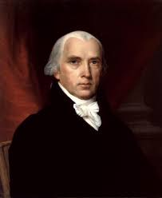
Slide #5
Legislature
Chamber 1
Chamber 2
You will review this section of the notes to create your own level 2 or 3 question or topic.
Virginia Plan:
  A proposal by James Madison to create a bi-cameral (2-chamber legislature).
  It also created the executive and judicial branches of government.
  Our national government with 3 branches was created with checks and balances to prevent the abuse of government power.

Slide 27
Slide #6
You will review this section of the notes to create your own level 2 or 3 question or topic.
Great Compromise:
  Also called the Connecticut Plan.
  Small states were afraid that they would not be equally represented in Congress in comparison to larger states.
  The Great Compromise was an agreement between smaller and larger states that balanced the number of representatives and senators could be elected from each state.
  A bi-cameral (2-chamber) legislature was proposed – Congress (Senate and House of Representatives.)
  Each state would have an equal number of senates. Currently, each state has 2 senators.
  Each state would elect representatives based upon the size of the state’s population.

Slide 28
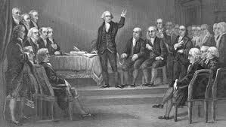

Slide 29
Slide #7
You will review this section of the notes to create your own level 2 or 3 question or topic.
Three-Fifths (3/5) Compromise:
  Slavery was a controversial issue.
  Should slaves be counted in a state’s population or not???
  A states population determined how many representatives each colony could elect the Congress in the House of Representatives.
  Delegates in the northern states were afraid the southern states would have more representatives because the slave population was included in the state’s overall population.
  The Three-Fifths Compromise allowed for slaves to count toward a state’s overall population by counting slaves as “3/5 of a person.”

Slide 30
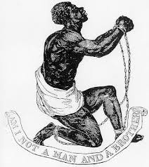
“Am I not a man and a brother?”

Slide 31
Slide #8
You will review this section of the notes to create your own level 2 or 3 question or topic.
Two representatives from Georgia participated in the Constitutional Convention and signed the constitution on behalf of Georgia.
They were Abraham Baldwin and William Few.
Both are considered “Founding Fathers” of our country.
Baldwin and Few voted for the 3/5 Compromise, allowing for slaves to be counted a state’s population.
Baldwin voted on the side of the small states when voting on the Virginia Plan.
  This decision evened the numbers for and against the Virginia Plan and allowed for the Great Compromise.

Slide 32
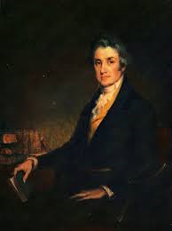
Slide #9
You will review this section of the notes to create your own level 2 or 3 question or topic.
Abraham Baldwin was originally from Connecticut.
Lived from 1754-1807.
A graduate of Theology from Yale University
Baldwin served as a chaplain in the U.S. Army during the American Revolution. After the war, he became a lawyer. Baldwin moved to Georgia in 1784 where he became a successful politician.
Baldwin is probably most famous for his role in the creation of the University of Georgia and his position as the University’s first president (1786-1801).

Slide 33
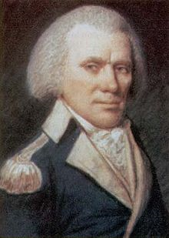
Slide #9 continued
You will review this section of the notes to create your own level 2 or 3 question or topic.
William Few, Jr. was born in North Carolina.
He lived from 1748-1828.
He was a soldier, judge, and legislator for Georgia and New York.
He’s buried in Augusta, GA.

Slide 34
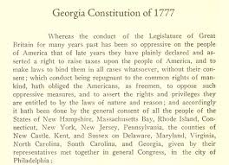
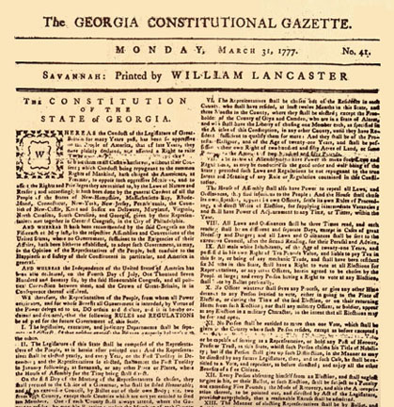
Back home in Georgia . . .
Georgia’s Provincial Congress and the Georgia Constitution of 1777

Slide 35
Georgia Performance Standards
SS8H4 The student will describe the impact of events that led to the ratification of the United States Constitution and the Bill of Rights.
a. Analyze the strengths and weaknesses of both the Georgia Constitution of 1777 and the Articles of Confederation and explain how weaknesses in the Articles of Confederation led to a need to revise the Articles.

Slide 36
Essential Question
What were the strengths and weaknesses of the Articles of Confederation and Georgia Constitution of 1777 and how were these weaknesses addressed?
How did past experience of the patriots with England’s monarchy influence their decisions regarding a new form of government?

Slide 37
Slide #10
You will review this section of the notes to create your own level 2 or 3 question or topic.
While the delegates from each state were meeting in Philadelphia to discuss and create the Articles of Confederation, things were going on here in Savannah, Georgia.
Georgia’s Provincial Congress was busy creating our state’s own constitution.

Slide 38
Slide #10 continued
You will review this section of the notes to create your own level 2 or 3 question or topic.
The Georgia Constitution of 1777 was our state’s first constitution.
It was similar to the Articles of Confederation (Oh No! That can’t be good.)

Slide 39
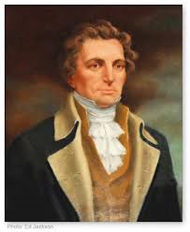
Slide #10 continued
You will review this section of the notes to create your own level 2 or 3 question or topic.
Though this constitution had three branches of government, most of the power was held by the unicameral (1-Chamber) legislative branch.
One of the legislative branch’s powers was the ability to appoint members of both the judicial and executive branch; including the state governor.
The governor, in turn, had very little power and a term limit of only one year.
John Treutlen was our state’s first governor.
Ladies, check out this handsome fella! LOL!

Slide 40
Slide #10 continued
You will review this section of the notes to create your own level 2 or 3 question or topic.
Though this constitution offered the citizens of Georgia many freedoms such as freedom of the press, freedom of religion, and trial by jury.
Georgians were not given the opportunity to ratify it.
With all of these weaknesses, the Georgia Constitution of 1777 was the state’s constitution for 12 years.
Georgia’s second constitution, the Constitution of 1789, was changed to model the U.S. Constitution.

Slide 41
Slide #10 continued
Strengths of the
Georgia Constitution of 1777
Weaknesses of the
Georgia Constitution of 1777
All three branches of government were created – legislative, executive, and judicial.
Georgia citizens had many rights.
The unicameral legislature was too powerful.
  ability to appoint members of both the judicial and executive branch.
  Appointed the state governor.
  Governor’s term was only 1-year long and had little power.

Slide 42
Graded Ticket-Out-the-Door
Review today’s notes by circling key terms, underlining main ideas, or highlighting key information.
Create your own level 2 or 3 question(s) for today’s notes.
Write a summary of what today’s notes were about. Not what you did in class today.

